Slide 1
CPEE1 – Professional Elective 1
(On-Line Technology)

Slide 2
Instructor Profile:
Doctor in Information Technology (AMAU, 2017)
- specialization: Data Mining, Machine Learning & Analytics
Master in Information Technology (MSEUF, 2010)
- specialization: Web Technologies
BS in Computer Engineering (AMAU, 2005)
- specialization: Software Engineering

Slide 3
What advice would
you give a new developer?

Slide 4
“Get comfortable with feeling uncomfortable”

Slide 5
“Do not be intimidated, everyone starts somewhere”

Slide 6
“Do not focus on memorizing the syntax but make sure you understand the concept”

Slide 7
“Those who write out their notes by hand actually learn more”
Pam Mueller (Princeton) &
Daniel Oppenheimer (UCLA)

Slide 8


First things First

Slide 9

Front End Basics
HTML, CSS, JavaScript

Slide 10
HTML
Hypertext Markup Language
Structure of a Webpage
“Nouns” of a Webpage

Slide 11
CSS
Cascading Style Sheets
Style of HTML
“Adjectives” of a Webpage

Slide 12
JavaScript
Adds Logic & Interactivity to a page
“Verbs” of a webpage

Slide 13
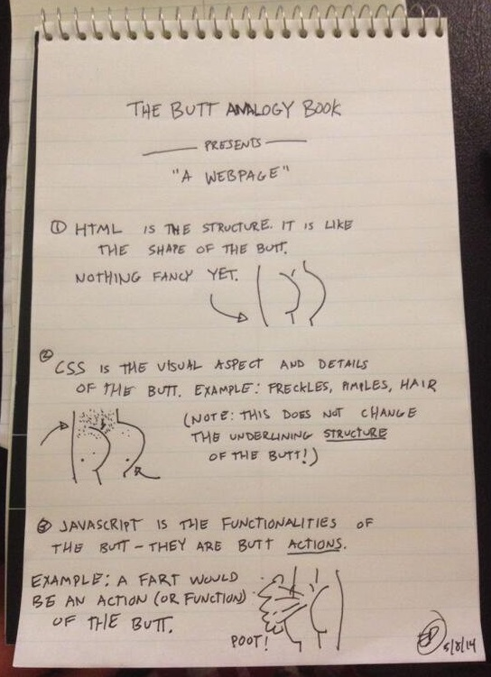

Slide 14
DEMO

Slide 15
HTML Basics

Slide 16
History of HTML
Created 1989/1990
Publishing & Exchanging of Scientific Documents
Electronic Linking of Documents (Hyperlinks)

Slide 17
The General Rule
<tagName> Some Content </tagName>

Slide 18
DEMO

Slide 19
HTML Boiler Plate &
Comments

Slide 20
DEMO

Slide 21
Basic Tags

Slide 22
Headings
<h1> to <h6>

Slide 23
Paragraphs
<p> … </p>

Slide 24
Emphasis
<strong> … </strong>
<em> … </em>

Slide 25
DEMO

Slide 26
Lists
<ol> <li> … </li> </ol>
<ul> <li> … </li> </ul>

Slide 27
DEMO

Slide 28
HTML List
Activity

Slide 29
Divs & Spans
<div> … </div>
<span> … </span>

Slide 30
DEMO

Slide 31
HTML Attributes
<tag name=“value”></tag>
<img src=“image.png”>
<p class=“selected”> woof woof </p>
<a href=“www.google.com”> Click to go to Google </a>
<link rel=“stylesheet” type=“text/css” href=“styles.css”>

Slide 32
Images
<img src=“image_url.png”>

Slide 33
Links
<a href=“url”> Link Text </a>

Slide 34
DEMO

Slide 35
Recreate
Web Page
Activity

Slide 36
INTERMEDIATE
HTML

Slide 37
Tables
<table><tr> … </tr></table>

Slide 38
DEMO

Slide 39
Table
Activity

Slide 40
Forms
<form>…</form>
<input>
<label> … </label>

Slide 41
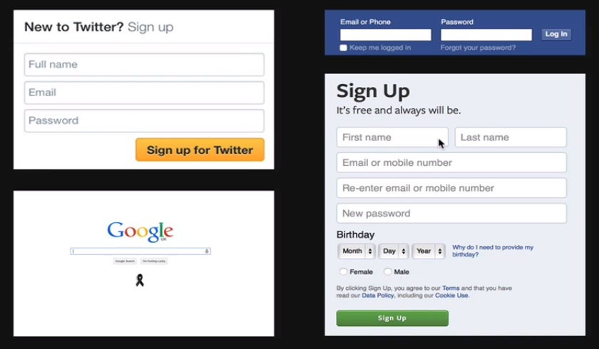

Slide 42
The <input> tag
button, text, radio,
checkbox, submit, password, file, hidden, reset

Slide 43
Notable Additions
email, url, color,
date, datetime,
time, month,
number, range

Slide 44
DEMO

Slide 45
The <label> tag

Slide 46
DEMO

